Slide 1
Why can’t Computers just talk to each other?
The hidden dangers of e-prescribing and bidirectional flow between physicians and pharmacies
Amanda Place, PharmD, BCACP
March 2021

Slide 2
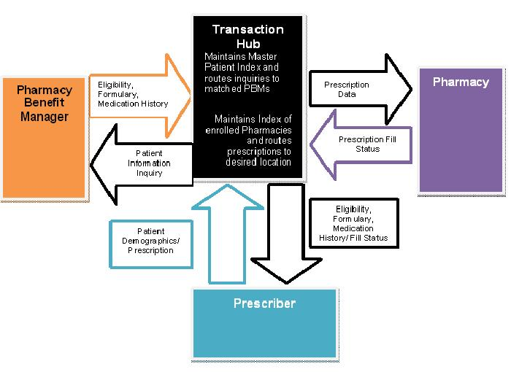
https://web.archive.org/web/20111229172808/http://www.hrsa.gov/healthit/toolbox/HealthITAdoptiontoolbox/ElectronicPrescribing/epreswork.html
Accessed 2/12/2021

Slide 3
When the system fails…
Special characters = “playing telephone”?
National Council for prescription drug Programs (NCPDP SCRIPT). (2021, February). Retrieved February 20, 2021, from https://www.arcesb.com/resources/edi/ncpdp-script.rst

Slide 5
When the system works as intended (but still fails)
Cancel Rx tasks
Best practices for “UD” or “prn”
Use of notes fields
Duration vs. days supply
Quantity and units of measure indicators
National Council for prescription drug Programs (NCPDP SCRIPT). (2021, February). Retrieved February 20, 2021, from https://www.arcesb.com/resources/edi/ncpdp-script.rst

Slide 6
Prevention Strategies
Use of Rx notes fields
Thorough medication reconciliation
Go “old-school”—increase healthcare provider communication
Question electronic data

Slide 7
Why can’t Computers just talk to each other?
The hidden dangers of e-prescribing and bidirectional flow between physicians and pharmacies
Amanda Place, pharmd, BCACP
March 2021

