Slide 1
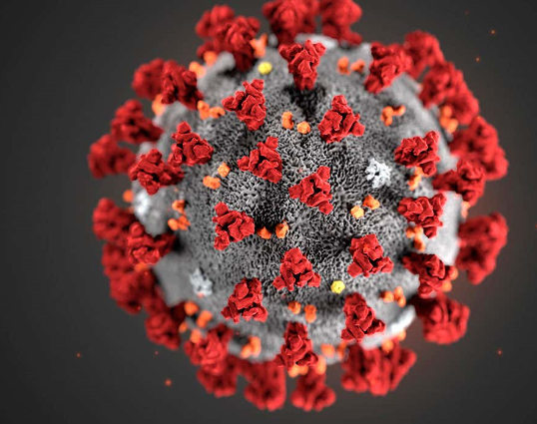
Exploring the Coagulopathic Nature of COVID-19 Midwest Medication Safety Symposium COVID Clinical Pearls
Laura Gillespie, PharmD
Regional Antimicrobial Stewardship Pharmacist
COVID-19 Incident Command Inpatient and Outpatient Care Teams Chair
COVID Coagulation Committee/Team
Saint Joseph Health System
Mishawaka and Plymouth Medical Centers, IN

Slide 2
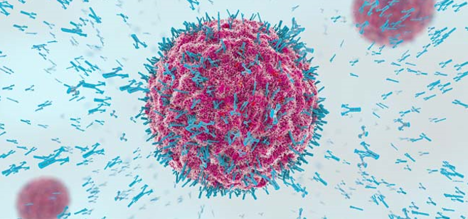
Learning Objective
Explain the coagulopathic nature of COVID-19, and identify key strategies to safely decrease the widespread propagation of microthrombi and tame the ensuing cytokine storm.
Develop an algorithm for appropriate anticoagulation in all COVID-19 patients
Understand when it is prudent to either escalate or deescalate anticoagulation
Learn how to avoid bleeding complications in COVID-19 patients
Develop a COVID-specific heparin drip dosing strategy (with lower drip rates and goal aPTTs than in non-COVID patients)
TEG (thromboelastography)➔use in COVID is off-label
General information: represent ongoing research

Slide 3
COAGULOPATHIES

Slide 4
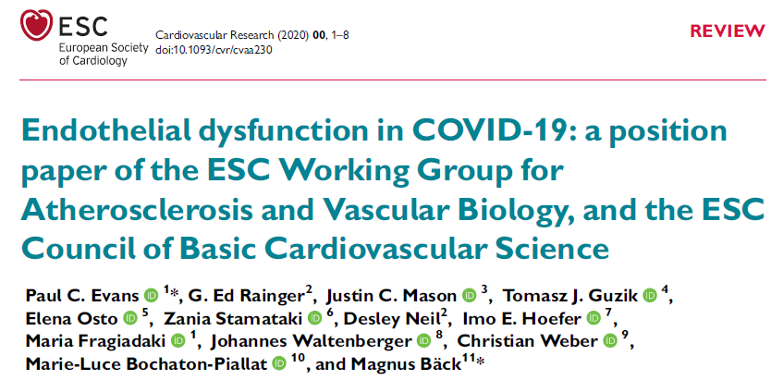

Slide 5
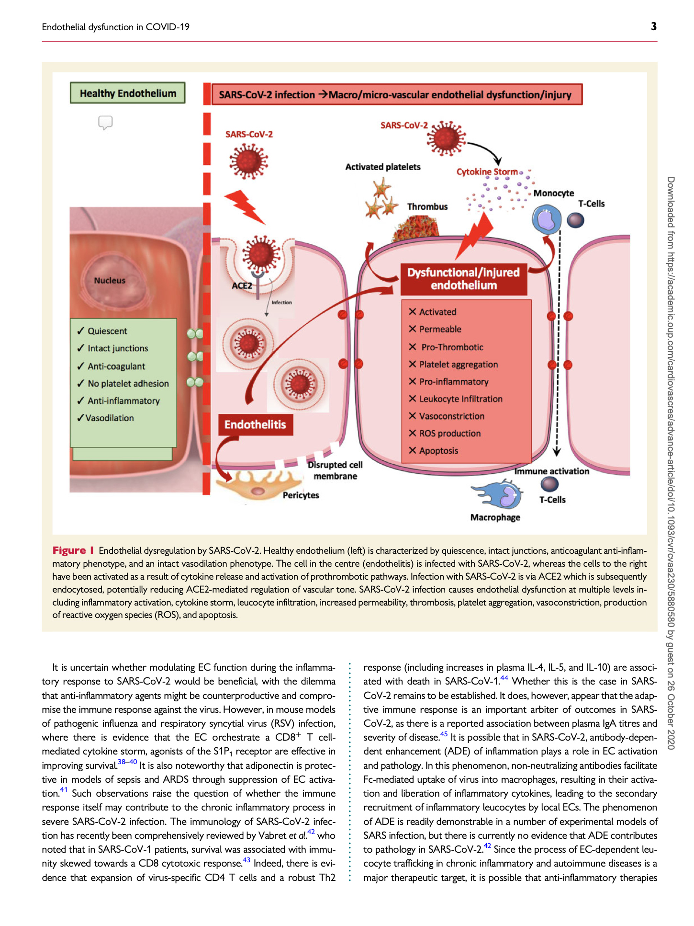
Vascular Endotheliitis: central feature of COVID-19
Key driver of
-cytokine dysregulation
-systemic coagulopathies
Cost of Blood Products during the pandemic. An argument for the “Third Way”:

Slide 6
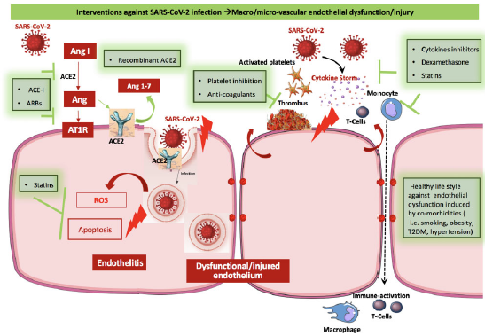

Slide 7
Fibrinogen and the clotting cascade
Notes:
Fibrinogen = Blood clotting protein from which fibrin is produced by action of the enzyme thrombin

Slide 8
COVID-19 Labs
Lab Markers Indicating "Severe COVID" Disease:
d-dimer >1,
creatine kinase (CK) >2X ULN (>600),
CRP >100,
LDH >245,
increased troponin,
ferritin >300,
absolute lymphocyte count (ALC) <0.8
Other Important Labs:
*Fibrinogen-prothrombotic
*D-dimer-fibrin degradation product (coagulation activation marker)
IL-6
Hgb, plts
Cytokine Storm:
-Cytokine-normal immune response
-Large amount cytokines all at once
➔ harmful (kills tissues / damages
organs)
-↑ Inflammatory Labs
Notes:
Cytokines play important role in normal immune responses, but large amt released all at once = harmful

Slide 9
COVID-19 VTE Algorithm
Rationale for early anticoagulation
Pathophysiology of COVID-19 associated respiratory disease is consistent with pulmonary vascular thromboemboli
Autopsy studies have demonstrated venous thromboembolism in deceased coronavirus patients
Early anticoagulation is necessary to prevent propagation of microthrombi at disease presentation
Thrombotic complications➔strong determinant of high mortality rate
Strategies to prevent thrombosis central to treatments / critical importance (decreased mortality??)
*Not just a disease of the lungs!!

Slide 10
COVID-19 VTE Algorithm
Rationale for use of heparins (LMWH/UFH)
Anticoagulation: ↓es widespread microthrombi (found deceased coronavirus patients) ➔ ↓ed mortality
Antiinflammatory: Heparins down regulate inflammatory responses (IL-6, nuclear factor-kB); directly dampen immune activation
Antiviral: Heparins inhibit cell entry via multiple mechanisms
Non-heparin anticoagulant recommendations:
DOACs/warfarin do not appear to have these anti-viral /inflammatory properties
➔DOACs /warfarin (therapeutic) can be utilized in COVID hospitalized patients who are not in, or going into, a cytokine storm (Never in ICU patients)

Slide 11
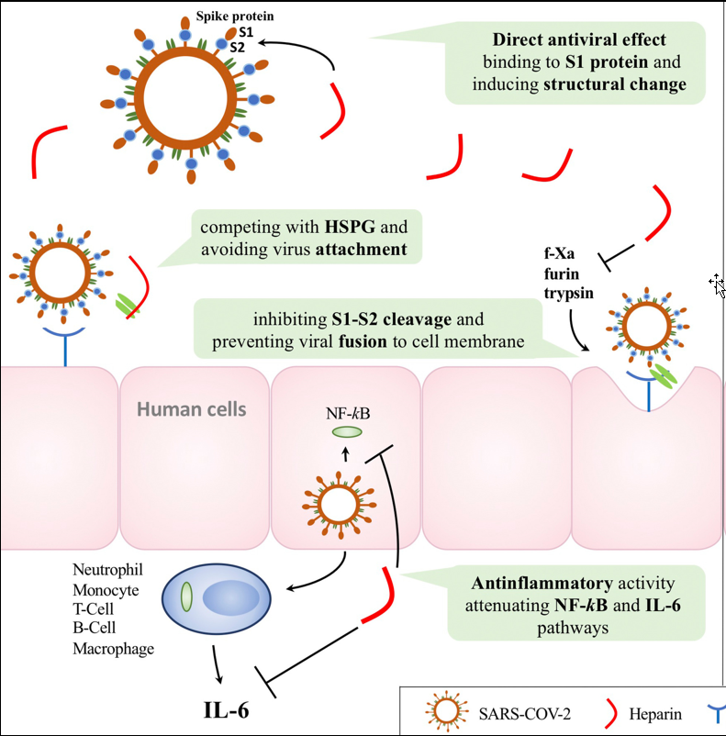
Heparins and anti-viral, immune modulating /inflammatory effects

Slide 12
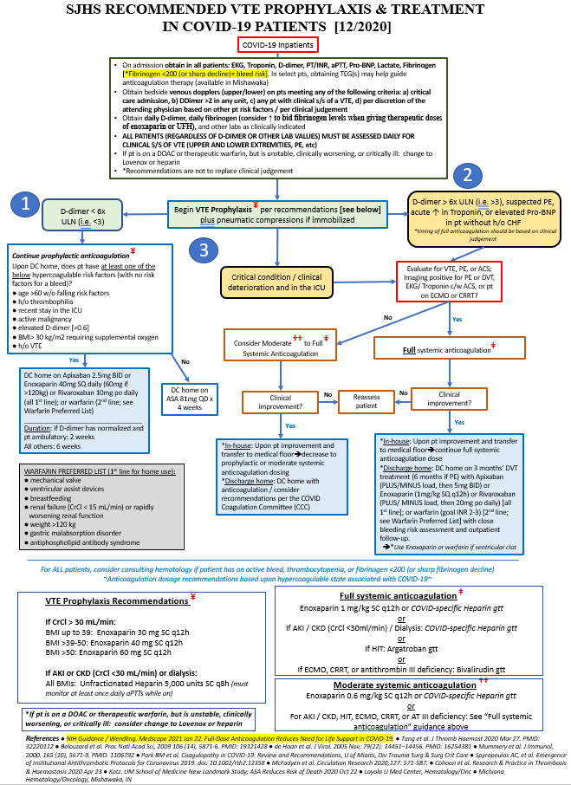
SJHS VTE Prophylaxis and Treatment Algorithm
Notes:
Note the references are now too numerable to fit all on this algorithm. Lots of data/support getting published….ours next!

Slide 13
Obtaining Dopplers (UE/LE):
Number of VTEs found per location (updated as of 11/3/20):
Cephalic: 12
Brachial: 9
Femoral: 10
Basilic: 8
Axillary: 4
IJV: 4
Iliac: 3
Popliteal: 3
Subclavian: 1
Peroneal: 1
Tibial: 1
Total 56: Upper (68%), lower (32%)
*3 COVID pts who have complained re: LE pain have had UE VTEs
COVID VTE Update as of 11/3/2020:
-58 affected pts (32: Sept thru Nov 3)
-67 total thrombotic events
22 PEs
56 DVTs (68% upper/32% lower)

Slide 14
When to Obtain Dopplers (UE/LE):
Only obtain bilateral upper and lower extremity dopplers on those meeting the following criteria:
1. Critical care or PCU/ intermediate care admission
2. DDimer >2 in any unit
3. Any patient with clinical s/s of a VTE,
4. Per discretion of the attending physician based on other patient risk factors / per clinical judgement

Slide 15
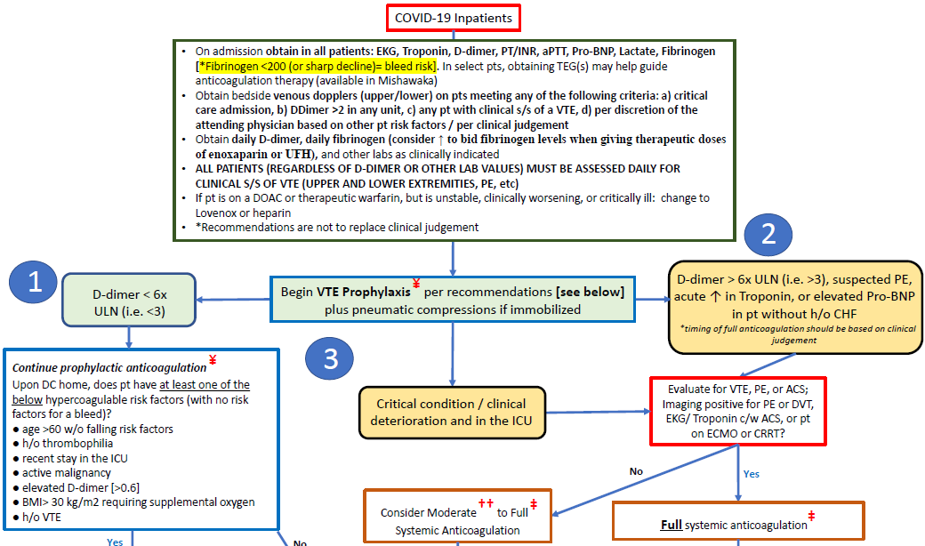
Consideration for TEGs

Slide 17
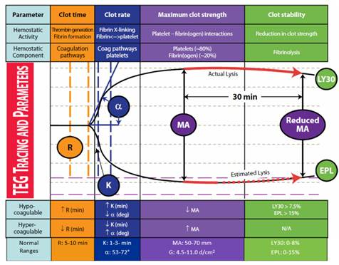
Thromboelastography (TEG)
Thromboelastography (TEG) = whole blood test / coagulopathy "big picture:“
patient's ability/time to clot (R value)
rate of increase in the clot (alpha angle)
strength of the clot (MA)
ability to break down the formed clot (LY30)
*better “overall picture” / representation than: aPTT, fibrinogen, platelets, coagulation factor levels

Slide 18
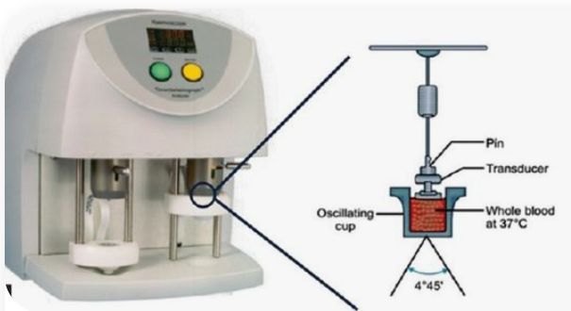
Thromboelastography (TEG)
Testing Procedure: small amount of blood is placed in a cup with a pin that is suspended from a torsion wire that is continuously oscillating. This mimics the patient's in vivo thrombus formation, and transfers the information into a graph.

Slide 19
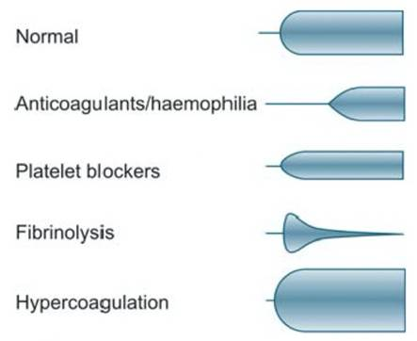
Thromboelastography (TEG)

Slide 20
TEG / COVID
COVID-19: disease state that is at times
Hypercoagulable (usually coincides with the cytokine storm, need for anti-inflammatory and anti-viral properties)
Hypocoagulable (usually after the cytokine storm is over and clinical improvement, but can be intermittent throughout the storm)
KEY LABS:
*D-dimer-coagulation activation marker
*Fibrinogen-prothrombotic (500+)-triggered by inflammation
and/or tissue damage

Slide 21
TEG / COVID
COVID-19:
TEGs gather real-time evaluation of patient's anticoagulation needs
Prevent patients from bleeding
Prevent patients from throwing clots
DVTs / PEs
widespread microthrombi into key organ systems (*researchers find in COVID patient autopsy reports)

Slide 22
TEG Example: Before and After The Storm
GM admit to med floor on 7/18 on R.A. Respiratory status quickly deteriorated, transfer to ICU 7/22 on bipap. Left TEG below (7/23) shows hypercoagulable state. Lovenox escalated from 30mg BID to 1mg/kg q12h. Clinically improved and tx to med floor 7/30, on R.A. (Right TEG below).
*“Heparinase” samples
7/30: Room Air
R 7.2, MA 55.5
7/23: on bipap
R 5.6, MA 70.7
MA
R
R
MA
*Critical time to deescalate AC*
Notes:
MRN 31076333
Something we learned back in summer: immediate de-escalation upon pt improvement

Slide 23
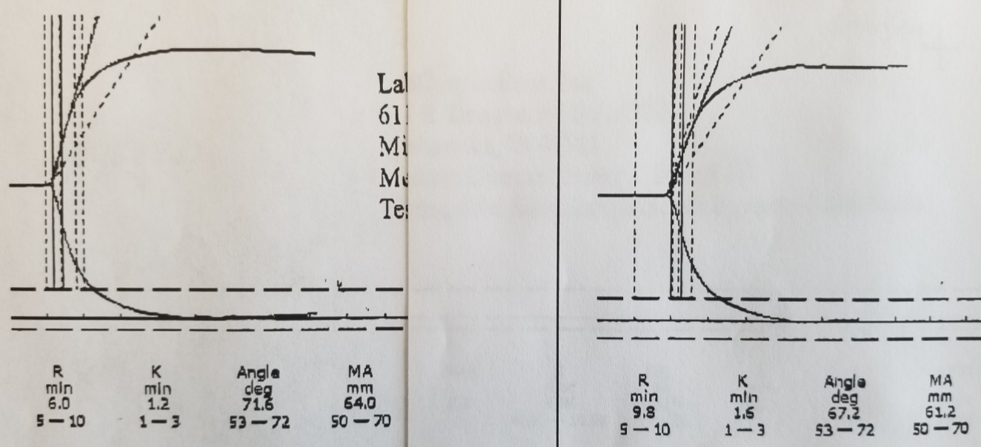
TEG Example: Heparinase vs Kaolin
Kaolin (activator to trigger the coagulation pathway)
Kaolin with Heparinase (lyses the heparin to deactivate it; gives visualization of the body’s coagulation w/o heparin on board)
Pt GM on Lovenox 1mg/kg q12h
Heparinase Sample
(body’s natural coagulopathy)
Kaolin Sample
(Lovenox anticoagulation effects)
R
MA
R
MA
R 6, MA 64
R 9.8, MA 61.4

Slide 24
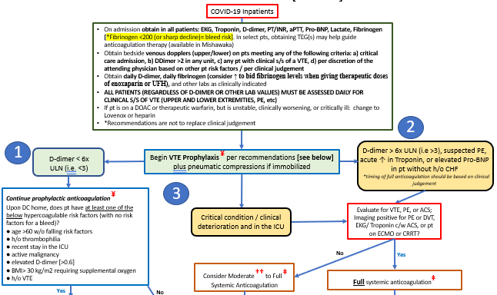
WHEN IS IT TIME TO ESCALATE?

Slide 25
Example AC Escalation:
When to Involve the Coagulation Team:
Pt TRW (MRN 461796); Admit 10/2pm to Med Floor
10/3-6: oxygen supplementation needs: 35-45L high flow, 70-90% FiO2
CRP: 160->193
Ferritin: 498->672
Fibrinogen: 798
Ddimer: 0.57->0.99->1.14->1.38→7.97
Pt on Lovenox 30mg bid
~~~~~~~~~~~~~~~~~~~~~~~~~~~~~~~~~~~~~~~~
10/7 Doppler US: R complete basilic vein DVT from elbow to mid upper arm
Consideration for AC Escalation:
High oxygen supplementation needs (or needs ↑ing)
DDimer trending ↑
Fibrinogen trending ↑
Inflammatory labs trending ↑ (or just not improving)

Slide 26
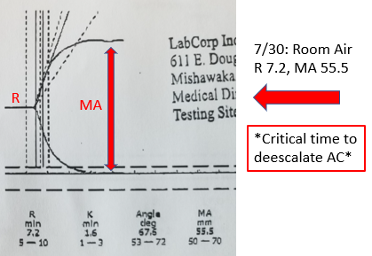
Deescalation in Hypocoagulation COVID HYPOCOAGULABILITY
COVID-19: disease state that is at times
Hypocoagulable (usually after the cytokine storm is over and clinical improvement, but can be intermittent throughout the storm)
KEY LABS:
*D-dimer-coagulation activation marker
*Fibrinogen-prothrombotic (500+)-triggered by inflammation
and/or tissue damage

Slide 27
Fibrinogen and the clotting cascade
Notes:
Fibrinogen = Blood clotting protein from which fibrin is produced by action of the enzyme thrombin

Slide 28
COVID HYPOCOAGULABILITY
➔Rec to obtain daily fibrinogen (consider ↑ to bid fibrinogen levels when giving therapeutic doses of enoxaparin/UFH, when levels in the 200s)
**Fibrinogen plus ddimer plus Hgb/plts (and aPTTs if on UFH) are critical**
-replete with cryoprecipitate for fibrinogen <200 if on moderate to therapeutic AC doses, <150 if on prophylactic doses or when on a DOAC (especially if not obtaining TEGs)
**This plus ddimer (and aPTTs if on UFH) are especially critical if TEG monitoring is not an option

Slide 29
HEPARIN (UFH) IN COVID
Notes:
To finish our discussion on coagulopathies / use of TEGS—nuiances treatment with UFH

Slide 30
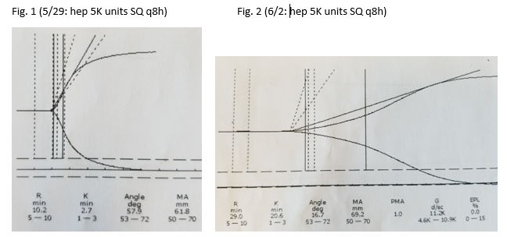
Heparin in COVID-19
Extreme hypersensitivity to UFH (not Lovenox)
TEG examples
aPTT monitoring
SQ doses may result in therapeutic levels, or upwards of >100
Lower aPTT range gives therapeutic results
Notes:
SQ heparins should have daily aPTT labs!

Slide 31
Heparin Drip Dosing Policy
All COVID patients: NO BOLUSES
HS: + PE=> 70unit/kg bolus, then 16units/kg/hr. Baseline aPTT 29.6→115.7 at 6hrs
H/H dropped significantly; unknown source of bleed
Diagnosis one month PTA
SD: + PE, segmental branch to RUL=> 70units/kg bolus, 16units/kg/hr. Baseline aPTT 27.9→135.7 at 6hrs
Immediate bleeding from chest tube
5 days feeling ill
MM: + R brachial DVT=> 70unit/kg bolus, 16units/kg/hr. Baseline aPTT 31.9→145.2 at 6hrs
Immediate L upper anterior abdominal wall intramuscular hematoma
Diagnosis <1 week PTA
ES: + PE=> 70unit/kg bolus, 16units/kg/hr x 34min, shut off x 46min (IR); restart at 12units/kg/hr x 2hr Baseline aPTT <21→139.1 at 2hrs
One week into illness
Notes:
Mention timeframes in disease course

Slide 32
Heparin Drip Dosing Policy
All COVID patients: NO BOLUSES
INTERMEDIATE AC:
Drip rate of 8 units/kg/hr
Goal aPTT: 37-45 (1.5x baseline)
FULL AC:
Drip rate 14 units/kg/hr
Goal aPTT: 50-59

Slide 33
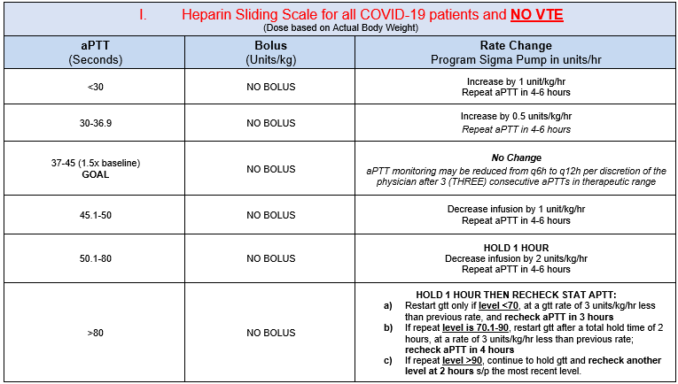
Anticoagulation Dosing Policy
I. COVID / NO VTE

Slide 34
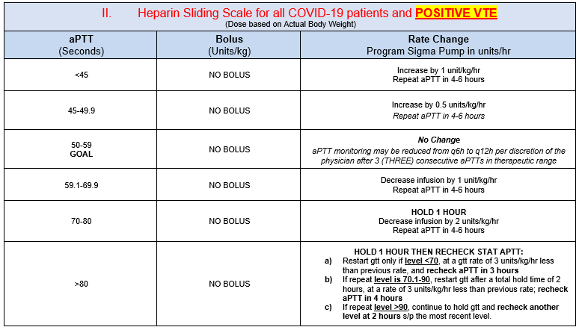
Anticoagulation Dosing Policy
II. COVID / POSITIVE VTE

Slide 35
OUTCOMES DATA
Notes:
To finish our discussion on coagulopathies / use of TEGS—nuiances treatment with UFH

Slide 36
Outcomes Data—Heparin /TEG Algorithm Work
Prior to Sept 16, 2020: 12 out of 33 patients studied had a bleeding event
Sept 16-Dec 1, 2020: one out of 71 patients had a bleeding event
Pre-print. Thromboelastography-Guided Management of Anticoagulated COVID-19 Patients to Prevent Hemorrhage. Semin Thromb Hemost 2021. In Press.
Pre-print. Thromboelastography-Guided Anticoagulant Therapy for the Double Hazard of Thrombohemorrhagic Events in COVID-19: A Report of Three Cases. Am J Case Rep. 2021. In Press.
Notes:
Note general successes

Slide 37
Outcomes Data—Overall Health System Success

Slide 38
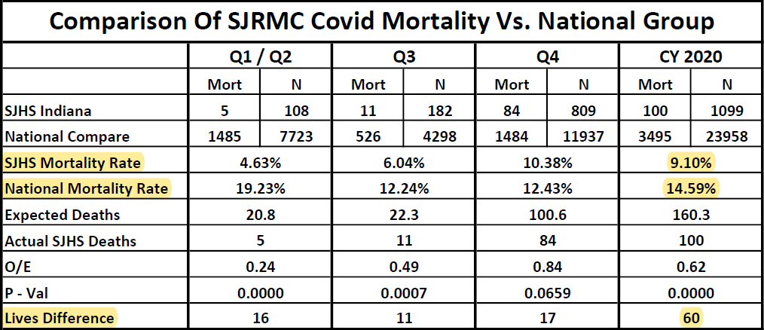
Outcomes Data—Overall Health System Success

Slide 39
References:
Pre-print. Thromboelastography-Guided Management of Anticoagulated COVID-19 Patients to Prevent Hemorrhage. Semin Thromb Hemost 2021. In Press.
Pre-print. Thromboelastography-Guided Anticoagulant Therapy for the Double Hazard of Thrombohemorrhagic Events in COVID-19: A Report of Three Cases. Am J Case Rep. 2021. In Press.
Evans P et al. Endothelial dysfunction in COVID-19: a position paper of the ESC Working Group for Atherosclerosis and Vascular Biology. Cardiovascular Research. Doi: 10.1093/cvr/cvaa230
Park BM et al. Coagulopathy in COVID-19: Review and Recommendations, U of Miami, Div Trauma Surg & Surg Crit Care.
NIH Guidance / Wendling. Medscape 2021 Jan 22. Full-Dose Anticoagulation Reduces Need for Life Support in COVID-19
Xiang-Hua et al. Am J Respir Crit Care Med, 182 (3), 436-7. PMID: 20675682
Tang et al. J Thromb Haemost 2020 Mar 27. PMID: 32220112
Belouzard et al. Proc Natl Acad Sci, 2009 106 (14), 5871-6. PMID: 19321428
Kotz. UM School of Medicine New Landmark Study; ASA Reduces Risk of Death 2020 Oct 22
Spyropoulos AC, et al. Emergence of Institutional Antithrombotic Protocols for Coronavirus 2019. doi: 10.1002/rth2.12358
Loyola University Medical Center, Hematology/Oncology and Michiana Hematology/Oncology, Mishawaka, IN
Hartmann J et al. The Role of TEG Analysis in Patients with COVID-19-Associated Coagulopathy: A Systematic Review. Diagnostics 2021, 11, 172.
Brubaker L et al. Thomboelastography Might Be More Applicable to Guide Anticoagulant Therapy than Fibrinolytic Therapy in Critically Ill Patients with COVID-19. J Am Coll Surg. 2021 Feb; 232(2):227-229.

Slide 40
QUESTIONS?

